Slide 1
RATINGS PREDICTION
Submitted by:
Yogesh.C.Mudliar

Slide 2
Problem Statement
We have a client who has a website where people write different reviews for technical products.
Now they are adding a new feature to their website i.e. the reviewer will have to add stars (rating) as well with the review.
Now they want to predict ratings for the reviews which were written in the past and they don’t have a rating.
So, we have to build an application which can predict the rating by seeing the review.

Slide 3
5 Reasons Why You’re E-Commerce Company Needs Ratings & Reviews
Generate Trust
Strengthen Marketing Efforts
To Drive More Revenue
Increase Visibility on Google
Optimize Strategy

Slide 4
Exploratory data analysis
Defining the question
Collecting the data
Cleaning the data
-Removing major errors, duplicates
-Removing unwanted data points
-Bringing structure to your data
-Filling in major gaps
Analyzing the data
Sharing your results

Slide 5
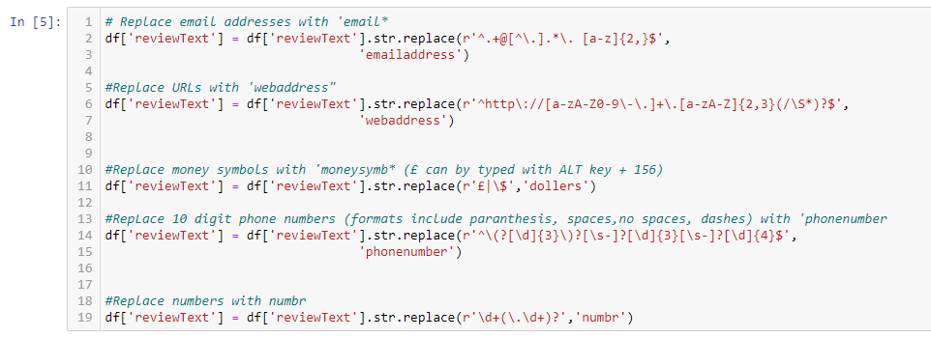
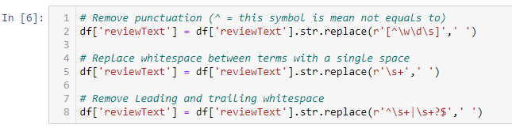
Removed all unnecessary data, punctuation, and Remove stop words

Slide 6
Identification of possible problem-solving approaches
Read dataset and make it in proper format.
Encode labels
Convert all cases to lower: I will now convert the text to all lowercase. Our machine learning algorithms recognize words that start with a capital letter as different words, and we will convert them to lowercase. Thus, our machine learning algorithms will not perceive words that start with a capital letter as a different word.
Remove punctuations
Remove Stop words
Check stats of messages
Convert all texts into vectors
Import classifier
Train and test
Check the accuracy/confusion matrix

Slide 7
Testing of Identified Approaches (Algorithms)
sklearn.feature_extraction.text import TfidfVectorizer
sklearn.model_selection import train_test_split
sklearn.svm import LinearSVC
sklearn.metrics import classification_report

Slide 8
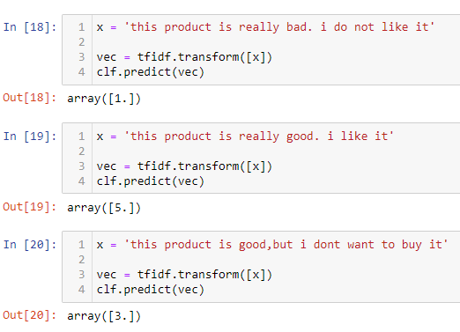
Interpretation of the Results
We want to predict ratings for the reviews which were written in the past and we don’t have a rating. So, we have to build an application which can predict the rating by seeing the review. We build an application that can predict ratings according to the given reviews.

Slide 9
CONCLUSION
Especially since 92% of consumers now read online reviews, E-Commerce businesses need to rethink their strategies for implementing the proper digital strategy in order to take advantage of the viral effects that customer reviews have.
Generating brand reputation and product value by aligning your feedback with your marketing strategies is the perfect way to convert visitors into loyal customers.
The better you know your customers, then the better original and unique content you can provide for them.
Collecting reviews and ratings enables you to gain insight into what user-generated content your audience prefers and provides search engine crawlers with the content needed to properly evaluate a website.

Slide 10


